Slide 1

Course : COMP6176 / Human - Computer Interaction
Year : 2019
DATA ANALYSIS, INTERPRETATION, AND PRESENTATION
SESSION 09

Slide 2
LEARNING OUTCOMES
LO 3: Choose the data gathering technique from user to develop successful interaction design
LO 4: Design the user requirements with interaction styles

Slide 3
OUTLINE
^{Introduction}
^{Qualitative and Quantitative}
^{Basic Quantitative Analysis}
^{Basic Qualitative Analysis}
^{Using Theoretical Frameworks}
^{Tools to Support Data Analysis}
Interpreting and Presenting the Findings

Slide 4
INTRODUCTION
The kind of analysis that can be performed on a set of data will be influenced by the goals identified at the outset, and the data actually gathered.
Most analysis, whether it is quantitative or qualitative , begins with initial reactions or observations from the data.
This initial analysis is followed by more detailed work using structure frameworks or theories to support the investigation.

Slide 5
INTRODUCTION
Interpretation of the finding often proceeds in parallel with analysis, but there are different ways to interpret results and it is important to make sure that the data supports your conclusions.
Finding the best way to present your findings depend on : your goals, the audience for whom the results were produced.

Slide 6
QUALITATIVE & QUANTITATIVE
Quantitative data :
  Data that is in the form of numbers, or that can easily be translated into numbers.
  Example : the number of years’ experience the interviewees have
Qualitative data :
  It is not expressed in numerical terms.
  Example : quote from interviewees, vignettes of activity, and images.

Slide 7
The First Steps in Analyzing Data
QUALITATIVE & QUANTITATIVE
There is some initial processing of the data required before data analysis can begin in earnest.
Data gathered and typical initial processing steps for the main data gathering techniques. See Table 9.1

Slide 8
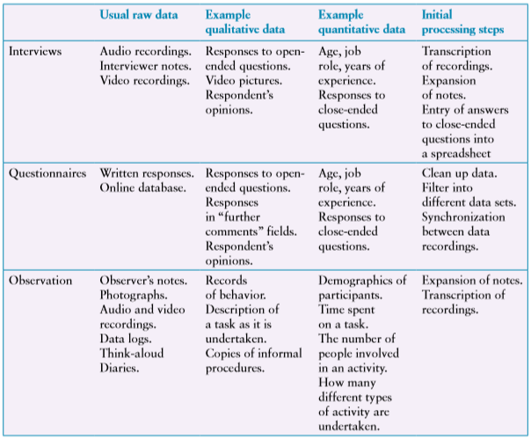
QUALITATIVE & QUANTITATIVE
  Table 9.1 Data Gathered and Initial Processing

Slide 9
BASIC QUANTITATIVE
ANALYSIS
The technique for simple quantitative analysis are : average and percentages.
There are three different types of average :
  Mean : the commonly understood interpretation of average
  Median : the middle value of the data after ranked
  Mode : the most commonly occurring number
The Quantitative data can usually be translated into rows and columns, where one row equals one record, e.g. respondent or interviewee

Slide 10
How Question Design Affects Data Analysis
BASIC QUANTITATIVE
ANALYSIS
For example : You have asked the question : “How do you feel about e-readers “ ?
Responses to this will be varied and there are many possibilities and the responses would need to be treated qualitatively

Slide 11
How Question Design Affects Data Analysis
BASIC QUANTITATIVE
ANALYSIS
Assumed that you have asked “ In your opinion, are e-readers easy to handle or cumbersome ?
This clearly reduces the number of options and you would then record the response as ‘easy to handle’ ,’cumbersome’, or ‘neither’.

Slide 12
How Question Design Affects Data Analysis
BASIC QUANTITATIVE
ANALYSIS
Assumed that you have asked “ In your opinion, are e-readers easy to handle or cumbersome ?
This clearly reduces the number of options and you would then record the response as ‘easy to handle’ ,’cumbersome’, or ‘neither’.

Slide 13
BASIC QUANTITATIVE
ANALYSIS
Respondent | Easy to Handle | Cumbersome | Neither
A | 1
B |  | 1
C |  | 1
…
Z |  |  | 1
Total | 14 | 5 | 7
Based on data above, there are 26 respondent, 14 out of 26 (54%) think e-readers are easy to handle, 5 out of 26 (15%) think they are cumbersome, and 7 out of 26 ( 27%) think they are neither easy to handle nor cumbersome.

Slide 14
How Question Design Affects Data Analysis
BASIC QUANTITATIVE
ANALYSIS
Another alternative which might be used in a questionnaire is to phrase the question in terms of a Likert scale, such as the one below.
In your opinion, are e-readers easy to handle :
Strongly Agree | Agree | Neither | Disagree | Strongly Disagree

Slide 15
BASIC QUANTITATIVE
ANALYSIS
Then the data could be analyzed using a simple spreadsheet or table :
Respondent | Strongly Agree | Agree | Neither | Disagree | Strongly Disagree
A |  | 1
B | 1
C |  |  |  | 1
…
Z |  |  |  |  | 1
Total | 5 | 7 | 10 | 1 | 3
For example : The result is 4 out of 26 ( 15%) disagreed with the statement that e-readers are easy to handle ( and of those, 3 (11,5%) strongly disagreed.

Slide 16
BASIC QUANTITATIVE
ANALYSIS
For simple collation and analysis, spreadsheet software such as Excel is often used as it is commonly available, well-understood and it offers a variety of numerical manipulations and graphical representations.
Producing a graphical representation of the data helps to get an overall view of the data and any patterns it contains.

Slide 17
BASIC QUALITATIVE
ANALYSIS
The first step in qualitative analysis is to gain an overall impression of the data and to start looking for the patterns.
There are three basic types of qualitative analysis :
  Identifying themes
  Categorizing data
  Analyzing critical incidents
There are not mutually exclusive and can be used in combination.

Slide 18
Identifying Themes
BASIC QUALITATIVE
ANALYSIS
As you become more familiar with the data, possible themes or patterns will emerge.
One common technique in qualitative analysis is the affinity diagram, which is used in contextual design.(Beyer and Holtzblatt,1998). It aims to organize individual ideas and insights into a hierarchy showing common structures and themes.

Slide 19
Categorizing Data
BASIC QUALITATIVE
ANALYSIS
The principle is that the data is divided up into elements and each element is then categorized.
Elements identified in the data are usually categorized first using a categorization scheme.
Which categories to use determined by the goal of the study.

Slide 20
Categorizing Data
BASIC QUALITATIVE
ANALYSIS
To illustrate categorization, we present an example derived from a set of studies looking at the use of different navigation aids in an online educational setting (Armitage,U.,2004). These studies involved observing users working through some online educational material, using the think-aloud technique.
An excerpt from the transcription is shown in Figure 09.01

Slide 21
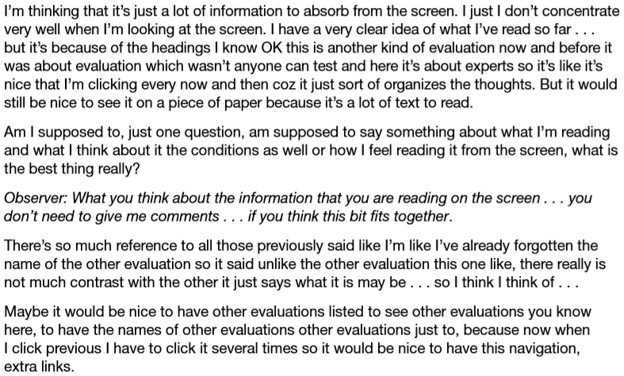
Categorizing Data
BASIC QUALITATIVE
ANALYSIS
    Figure 09.01 Excerpt from a transcript of a think-aloud protocol

Slide 22
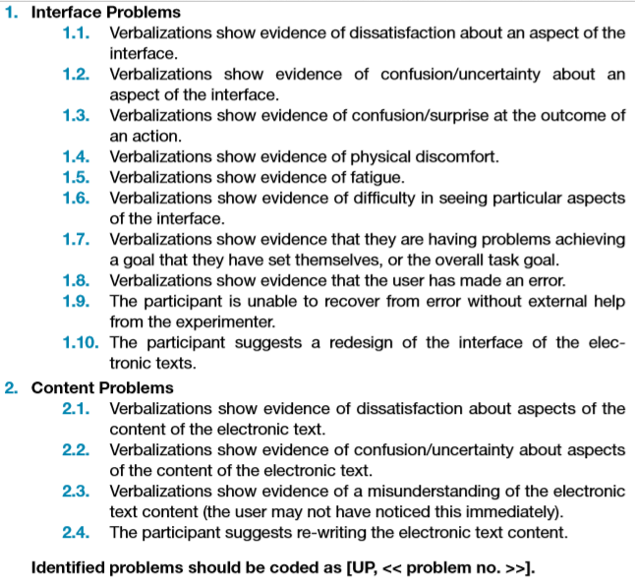
Categorizing Data
BASIC QUALITATIVE
ANALYSIS
This excerpt was analyzed using a categorization scheme derived from a set of negative effects of a system on a user given in van Rens (1997).The categorization scheme is shown in figure 09.02
Figure 09.02 The Categorization Scheme

Slide 23
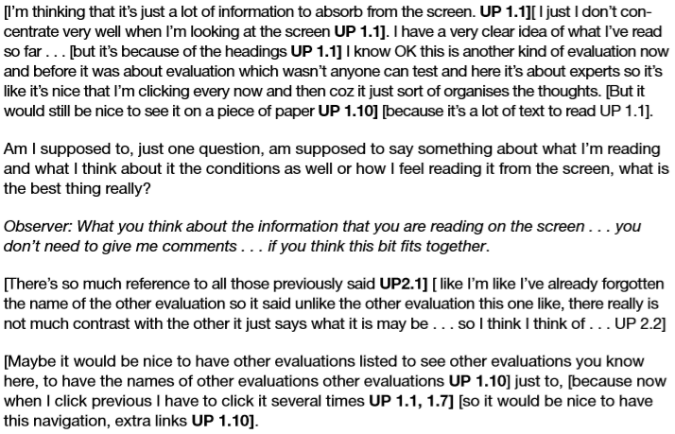
Categorizing Data
BASIC QUALITATIVE
ANALYSIS
This scheme developed and evolved as the transcript were analyzed. The transcript is divided up using square brackets to indicate which element is being identified as showing a particular usability problem. (See Figure 09.03).
Having categorized the data, the results can be used to answer the study goals
Figure 09.03 The excerpt using the categorization scheme

Slide 24
Looking for Critical Incidents
BASIC QUALITATIVE
ANALYSIS
The Critical Incident technique is :
  a set of principles that emerged from work carried out in the United States Army Air Forces where the goal was to identify the critical requirements of good and bad performance by pilot (Flanagan,1954)
In interaction design, critical incident analysis has been used in a variety of ways, but the main focus is :
  to identify specific incidents that are significant,
  focus on these and analyze them in detail
  Using the reset of the data collected as context to inform interpretation.

Slide 25
Looking for Critical Incidents
BASIC QUALITATIVE
ANALYSIS
For example is reported in Curzon et al (2002), it identified a set of critical incidents through field trials of an in-car navigation device. One example incident in this context was “ On one journey, the system gave directions to turn right when the destination was to the left. Its route was tog o round the block to go in the other direction. A car following ignored this turn and went the more obvious way, arriving first.

Slide 26
USING THEORETICAL
FRAMEWORKS
There are several different analytical frameworks that can be used to analyze and interpret data from a qualitative study.
Six different approaches are outlined, ordered roughly in terms of their granularity, that is, the level of detail involved.
For example See Table 09.02

Slide 27
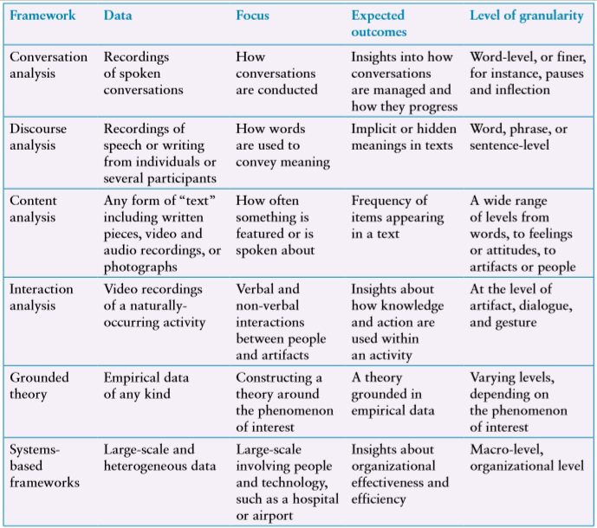
USING THEORETICAL
FRAMEWORKS
Table 09.02 Overview of analytical frameworks used in interaction Design

Slide 28
TOOLS TO SUPPORT
DATA ANALYSIS
Tools to support the organization and manipulation of data include :
  facilities for categorization
  Theme-based analysis
  Quantitative analysis
These typically provide facilities to associate labels ( categories, themes, and so on) with section of data, search the data for keywords or phrases, investigate the relationships between different themes or categories, and help to develop the coding scheme further, some packages can also generate graphical representation.

Slide 29
TOOLS TO SUPPORT
DATA ANALYSIS
One popular qualitative data analysis package is Nvivo from QSR International and SPSS (Statistical Package for the Social Sciences).

Slide 30
INTERPRETING & PRESENTING
THE FINDINGS
The best way to present findings depends on the audience and the original goals of the study . And also is dependent on the data gathering and analysis techniques used.
There are three kinds of presentation style :
  Structured Notations
  Using stories
  Summarizing the findings

Slide 31
INTERPRETING & PRESENTING
THE FINDINGS
Structured Notations :
  These notations follow a clear syntax and semantics, which have been developed to capture particular viewpoints.
  For example : the work models promoted in contextual design ( Beyer and Holtzblatt,1998) use simple but clear conventions for representing flows, breakdowns, individual roles, and so on.
  Advantages using a rigorous notations :
    The meaning of different symbols is well-defined, and so it provides clear guidance on what to look for in the data and what to highlight and that it enforces precision in expression.
  Disadvantage :
    By highlighting specific elements, it inevitably also downplays or ignores other aspects,
    The precision expressed by the notation may be lost on an audience if they don’t know the notation well.

Slide 32
INTERPRETING & PRESENTING
THE FINDINGS
Using Stories
  Storytelling is an easy and intuitive approach for people to communicate ideas and experiences.
  There are three different ways to tell the story :
    Participants may have told stories of their own during data gathering.
    Stories about participants may be employed.
    Stories may be constructed from smaller anecdotes or repeated patterns that are found in the data.

Slide 33
INTERPRETING & PRESENTING
THE FINDINGS
Summarizing the Findings
  Clearly written reports with an overview at the beginning and a detailed content list make for easy reading and a good reference document.
  Including anecdotes, quotations, pictures, and video clips helps to bring the study to life, stimulate interest, and make the written description more meaningful.

Slide 34

REFERENCES
Interaction Design 5th Edition 2019, Chapter 9
https://www.investopedia.com/terms/q/quantitativeanalysis.asp
https://research-methodology.net/research-methods/data-analysis/qualitative-data-analysis/
https://www.proschoolonline.com/blog/top-10-data-analytics-tools

